Slide 1
Database Systems:
Design, Implementation, and Management
Ninth Edition
Chapter 2
Data Models

Slide 2
Objectives
In this chapter, you will learn:
About data modeling and why data models are important
About the basic data-modeling building blocks
What business rules are and how they influence database design
How the major data models evolved
How data models can be classified by level of abstraction

Slide 3
Introduction
Designers, programmers, and end users see data in different ways
Different views of same data lead to designs that do not reflect organization’s operation
Data modeling reduces complexities of database design
Various degrees of data abstraction help reconcile varying views of same data

Slide 4
Data Modeling and Data Models
Data models
  Relatively simple representations of complex real-world data structures
    Often graphical
Model: an abstraction of a real-world object or event
  Useful in understanding complexities of the real-world environment
Data modeling is iterative and progressive

Slide 5
The Importance of Data Models
Facilitate interaction among the designer, the applications programmer, and the end-user
End users have different views and needs for data
Data model organizes data for various users
Data model is an abstraction

Slide 6
Types of data models
Conceptual data models are the most simple and abstract.
Physical data model
Hierarchical data model
Relational data model
Entity-relationship (ER) data model
Object-oriented data model
Data modeling software makers

Slide 7
Data Model Basic Building Blocks
Entity: anything about which data are to be collected and stored (Person, place, thing "noun” – that is stored) - Table
Attribute: a characteristic of an Entity
Relationship: describes an association among entities
  One-to-many (1:M or 1..* or 1:∞) relationship
  Many-to-many (M:N or M:M or *..* or ∞:∞) relationship
  One-to-one (1:1 or 1..1) relationship
Constraint: a restriction placed on the data (Limitation of data, ex: if our department only accept 14 faculties working!)
Notes:
When we create a data model we start to Data Model Basic Building Blocks

Slide 8


Slide 9
Business Rules
To Start it we have to follow these steps:
Descriptions of policies, procedures, or principles within a specific organization
  Apply to any organization that stores and uses data to generate information
Description of operations to create/enforce actions within an organization’s environment
  Must be in writing and kept up to date
  Must be easy to understand and widely disseminated
Describe characteristics of data as viewed by the company
Notes:
Business Rules or Organization Rules

Slide 10
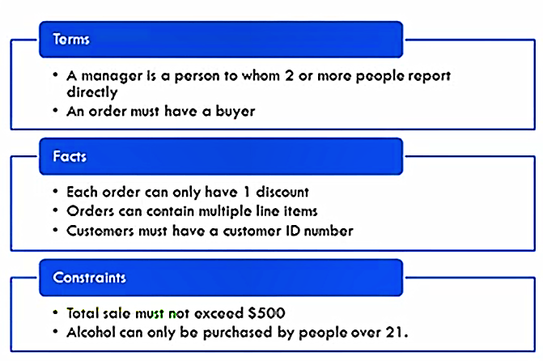
Example of Business Rules

Slide 11


Slide 12
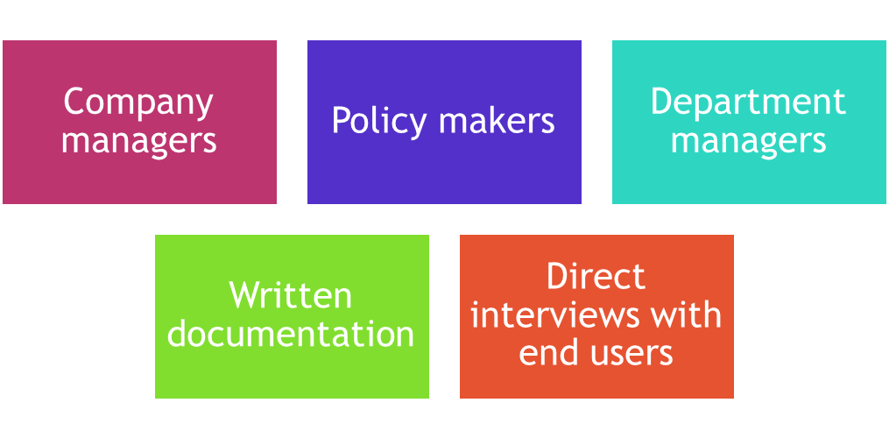
Discovering Business Rules
Sources of business rules:
  Company managers
  Policy makers
  Department managers
  Written documentation
    Procedures
    Standards
    Operations manuals
  Direct interviews with end users

Slide 13
Reasons for Identifying and Documenting Business Rules
Help standardize company’s view of data
Communications tool between users and designers
Allow designer to:
  Understand the nature, role, scope of data, and business processes
  Develop appropriate relationship participation rules and constraints
  Create an accurate data model

Slide 14
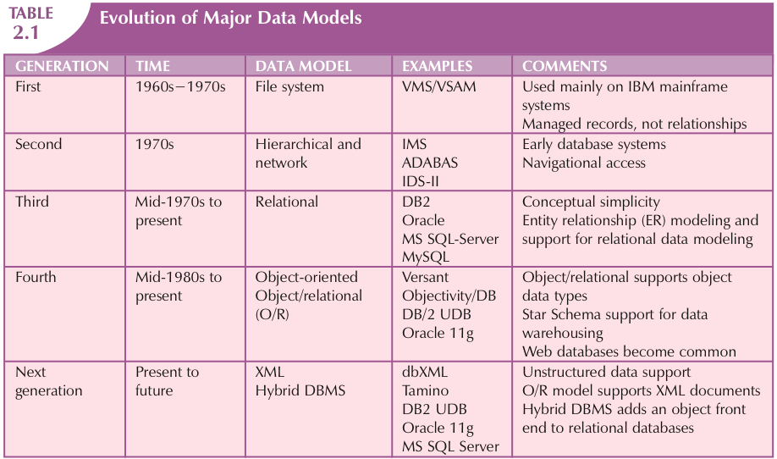
The Evolution of Data Models

Slide 15
Hierarchical and Network Models
Hierarchical Models
Network Models
Manage large amounts of data for complex manufacturing projects
Represented by an upside-down tree which contains segments
  Segments: Equivalent of a file system’s record type
Depicts a set of one-to-many (1:M) relationships
Represent complex data relationships
Improve database performance and impose a database standard
Depicts both one-to-many (1:M) and many-to-many (M:N) relationships

Slide 16
Hierarchical Model
Advantages
Disadvantages
Promotes data sharing
Parent/child relationship promotes conceptual simplicity and data integrity
Database security is provided and enforced by DBMS
Efficient with 1:M relationships
Requires knowledge of physical data storage characteristics
Navigational system requires knowledge of hierarchical path
Changes in structure require changes in all application programs
Implementation limitations
No data definition
Lack of standards

Slide 17
Network Model
Advantages
Disadvantages
Conceptual simplicity
Handles more relationship types
Data access is flexible
Data owner/member relationship promotes data integrity
Conformance to standards
Includes data definition language (DDL) and data manipulation language (DML)
System complexity limits efficiency
Navigational system yields complex implementation, application development, and management
Structural changes require changes in all application programs
Notes:
Braw pida-promots

Slide 18
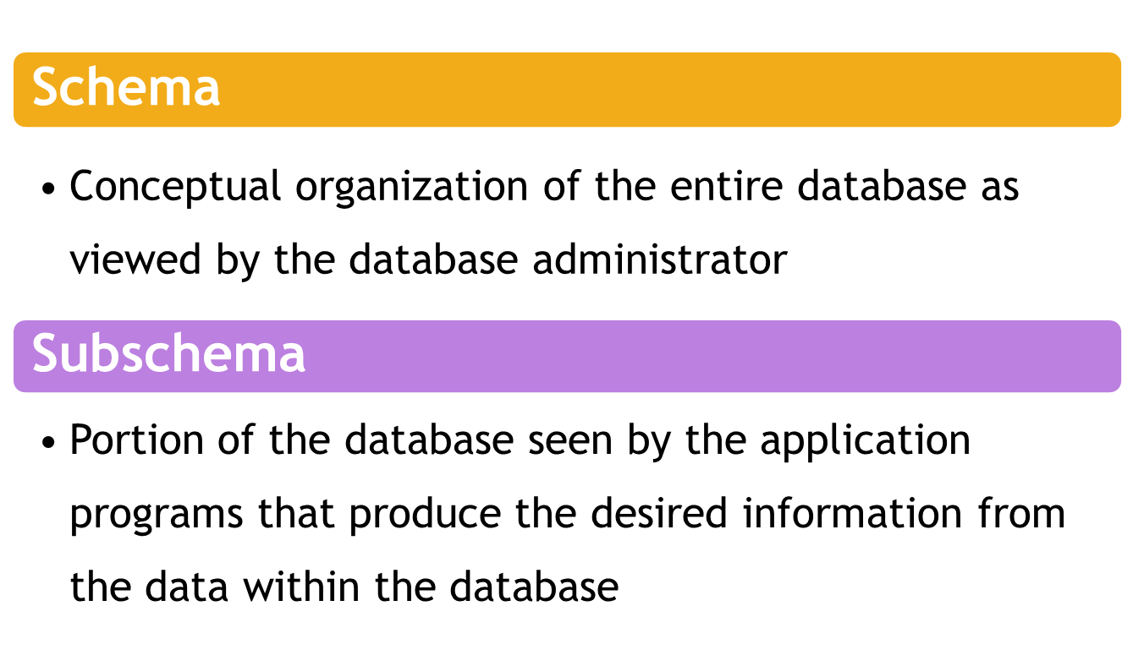
Standard Database Concepts

Slide 19
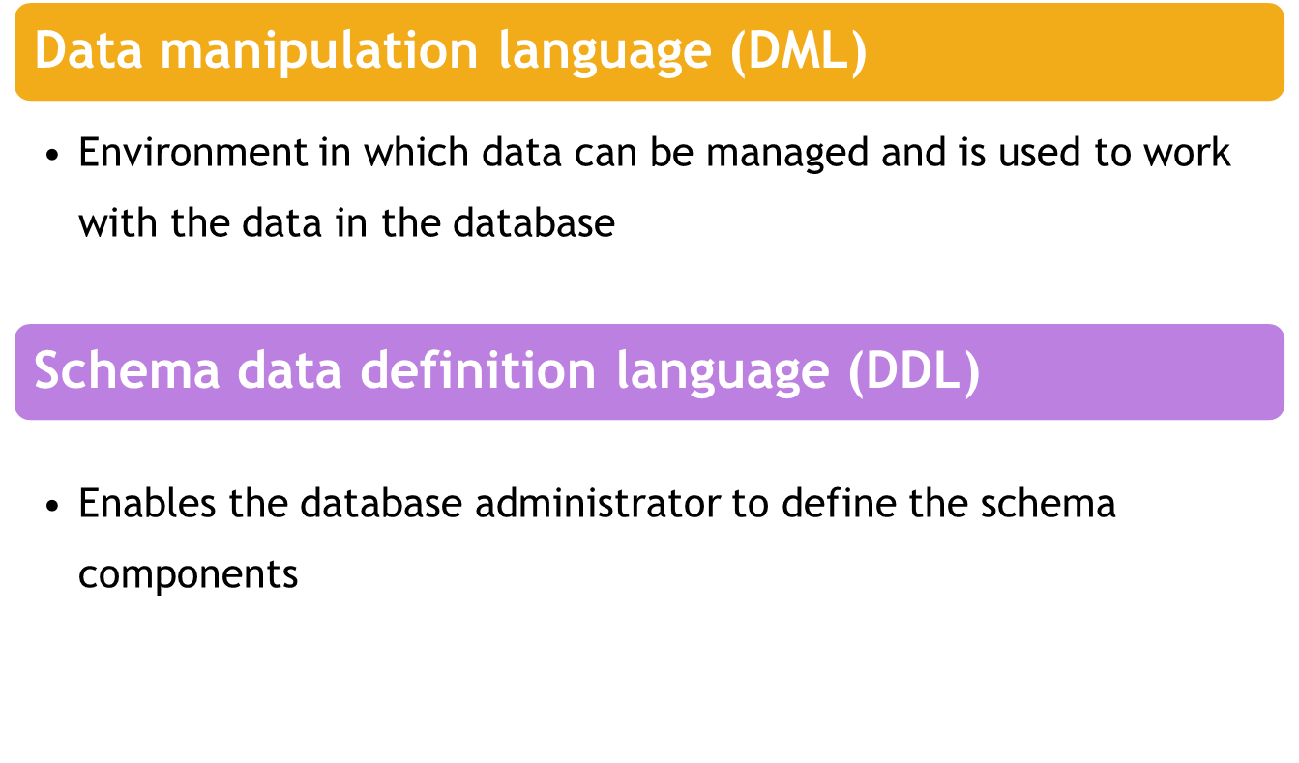
Standard Database Concepts

Slide 20
The Relational Model
Developed by E.F. Codd (IBM) in 1970
Table (relations)
  Matrix consisting of row/column intersections
  Each row in a relation is called a tuple
Relational models were considered impractical in 1970
Model was conceptually simple at expense of computer overhead

Slide 21
The Relational Model (cont’d.)
Relational data management system (RDBMS)
  Performs same functions provided by hierarchical model
  Hides complexity from the user
Relational diagram
  Representation of entities, attributes, and relationships
Relational table stores collection of related entities

Slide 22
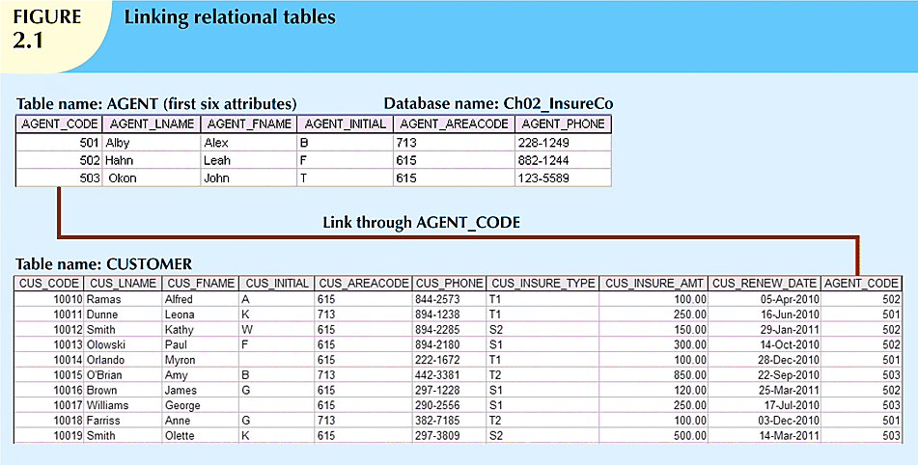

Slide 23
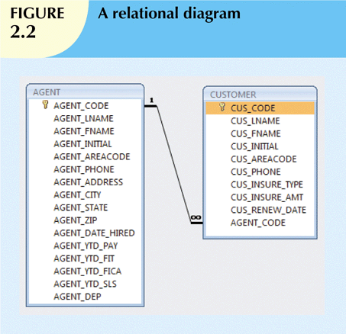

Slide 24
The Relational Model (cont’d.)
SQL-based relational database application involves three parts:
  User interface
    Allows end user to interact with the data
  Set of tables stored in the database
    Each table is independent from another
    Rows in different tables are related based on common values in common attributes
  SQL “engine”
    Executes all queries

Slide 25
The Entity Relationship Model
Widely accepted standard for data modeling
Introduced by Chen in 1976
Graphical representation of entities and their relationships in a database structure
Entity relationship diagram (ERD)
  Uses graphic representations to model database components
  Entity is mapped to a relational table

Slide 26
The Entity Relationship Model (cont’d.)
Entity instance (or occurrence) is row in table
Entity set is collection of like entities
Connectivity labels types of relationships
Relationships are expressed using Chen notation
  Relationships are represented by a diamond
  Relationship name is written inside the diamond
Crow’s Foot notation used as design standard in this book

Slide 27
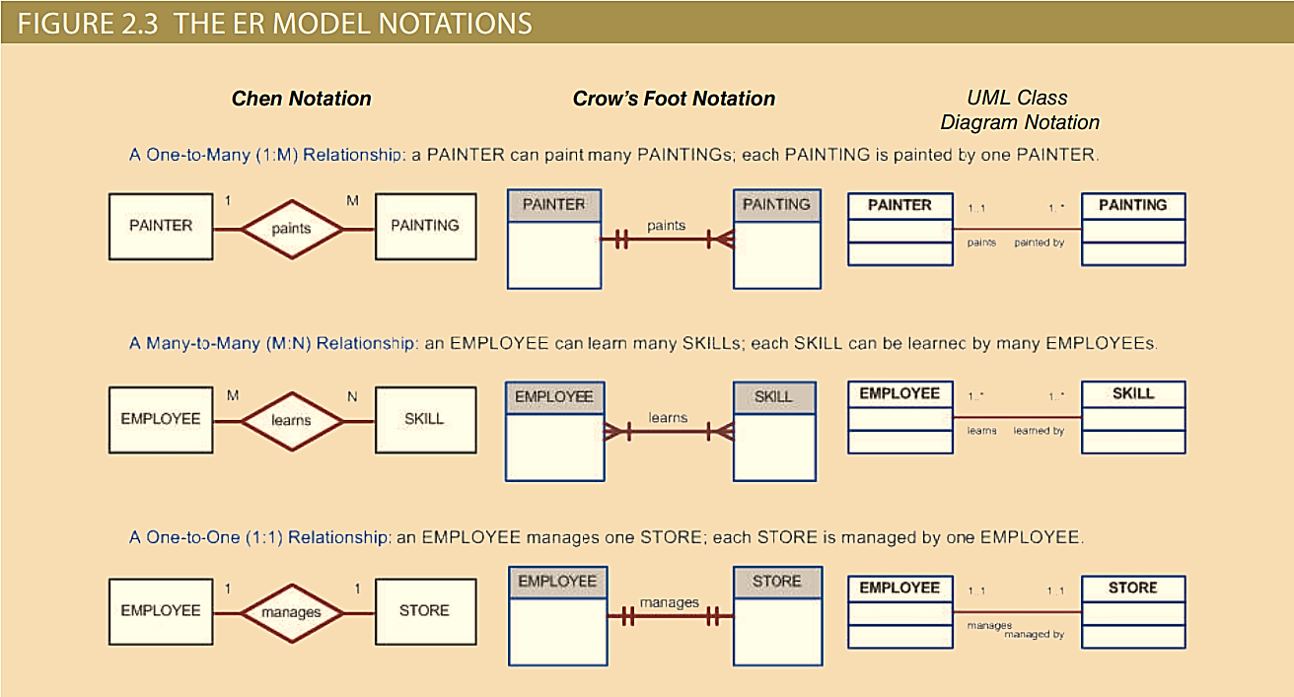

Slide 28
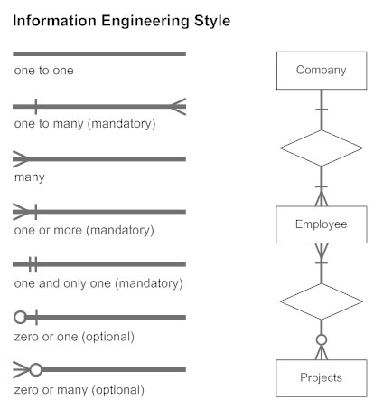

Slide 29
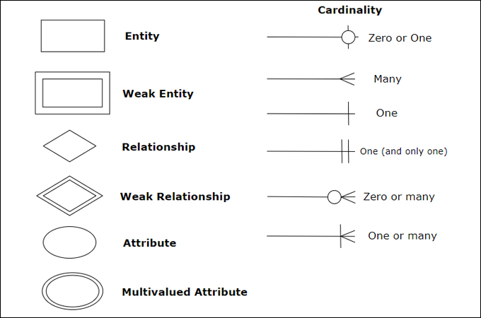

Slide 30
The Object-Oriented Data Model (OODM) or Semantic Data Model
Object-oriented database management system(OODBMS)
  Based on OODM
Object: Contains data and their relationships with operations that are performed on it
  Basic building block for autonomous structures
  Abstraction of real-world entity
Attributes - Describe the properties of an object

Slide 31
The Object-Oriented Data Model (OODM)
Class: Collection of similar objects with shared structure and behavior organized in a class hierarchy
  Class hierarchy: Resembles an upside-down tree in which each class has only one parent
Inheritance: Object inherits methods and attributes of parent class
Unified Modeling Language (UML)
  Describes sets of diagrams and symbols to graphically model a system

Slide 32
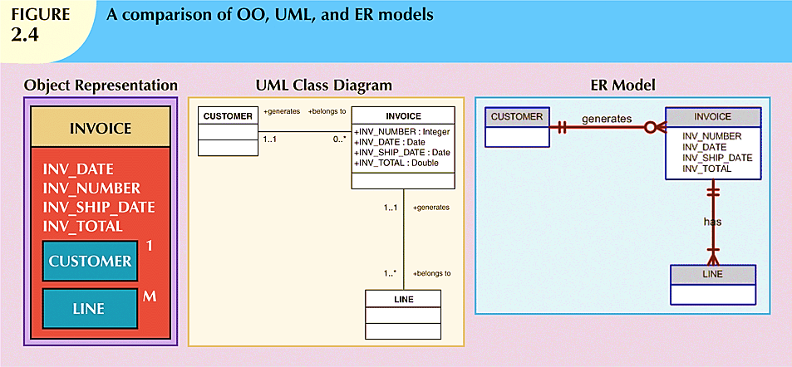

Slide 33
Newer Data Models:
Object/Relational and XML
Extended relational data model (ERDM)
  Semantic data model developed in response to increasing complexity of applications
  Includes many of OO model’s best features
  Often described as an object/relational database management system (O/RDBMS)
  Primarily geared to business applications

Slide 34
The Future of Data Models
Hybrid DBMSs
  Retain advantages of relational model
  Provide object-oriented view of the underlying data
SQL data services
  Store data remotely without incurring expensive hardware, software, and personnel costs
  Companies operate on a “pay-as-you-go” system

Slide 35
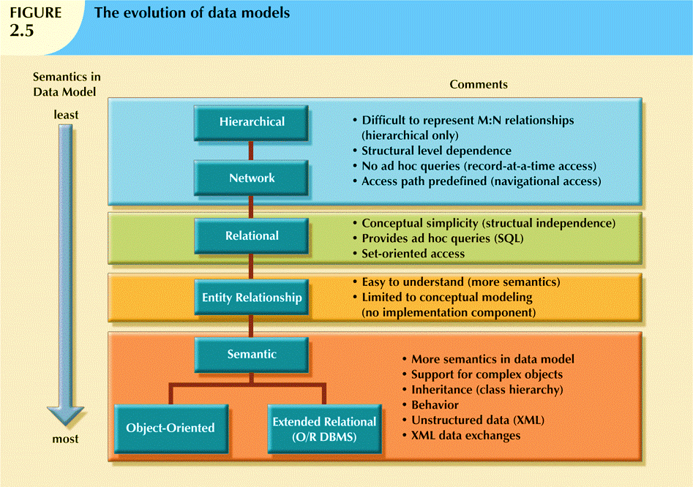

Slide 36
Big Data
Aims to:
  Find new and better ways to manage large amounts of web and sensor-generated data
  Provide high performance and scalability at a reasonable cost
Characteristics
  Volume
  Velocity
  Variety

Slide 37
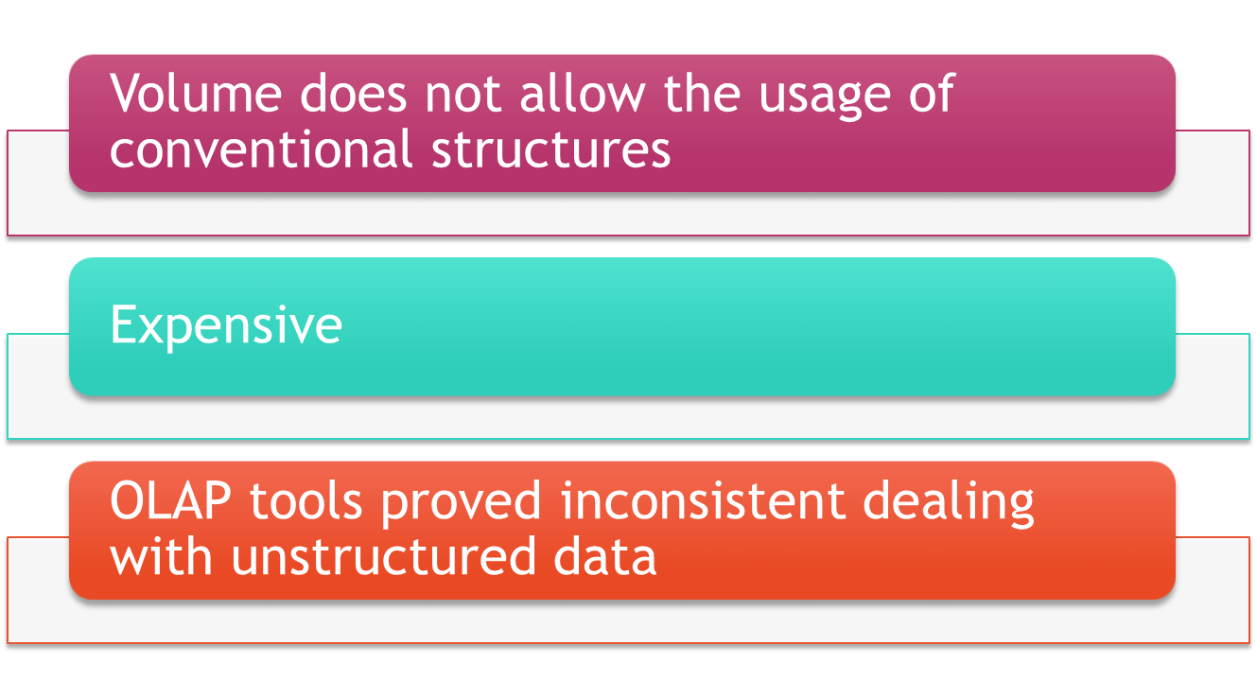
Big Data Challenges

Slide 38
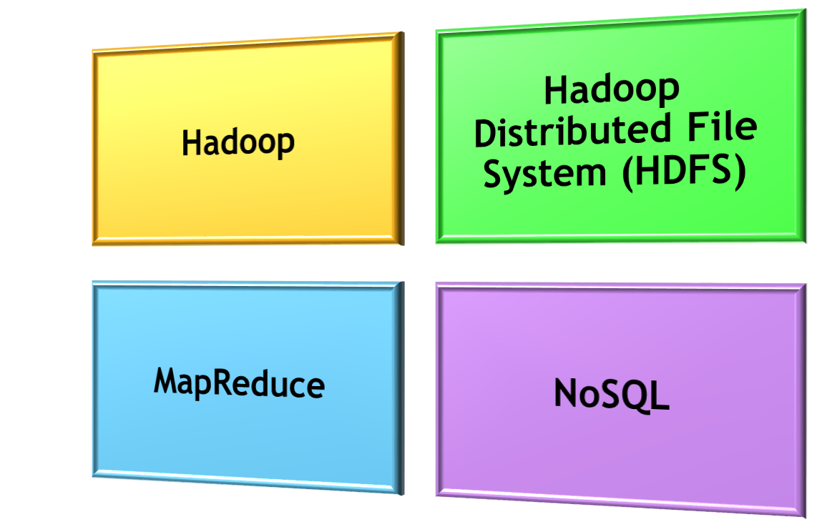
Big Data New Technologies

Slide 39
NoSQL Databases
Not based on the relational model
Support distributed database architectures
Provide high scalability, high availability, and fault tolerance
Support large amounts of sparse data
Geared toward performance rather than transaction consistency
Store data in key-value stores

Slide 40
NoSQL
Advantages
Disadvantages
High scalability, availability, and fault tolerance are provided
Uses low-cost commodity hardware
Supports Big Data
Key-value model improves storage efficiency
Complex programming is required
There is no relationship support
There is no transaction integrity support
In terms of data consistency, it provides an eventually consistent model

Slide 41
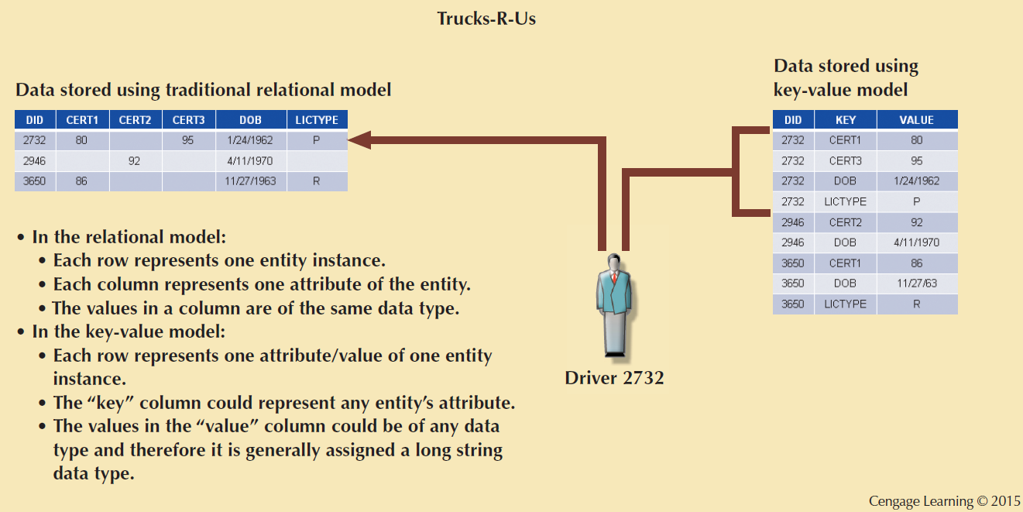
Figure 2.5 - A Simple Key-value Representation

Slide 42
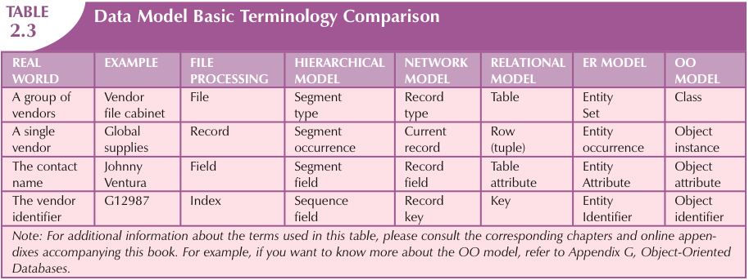

Slide 43
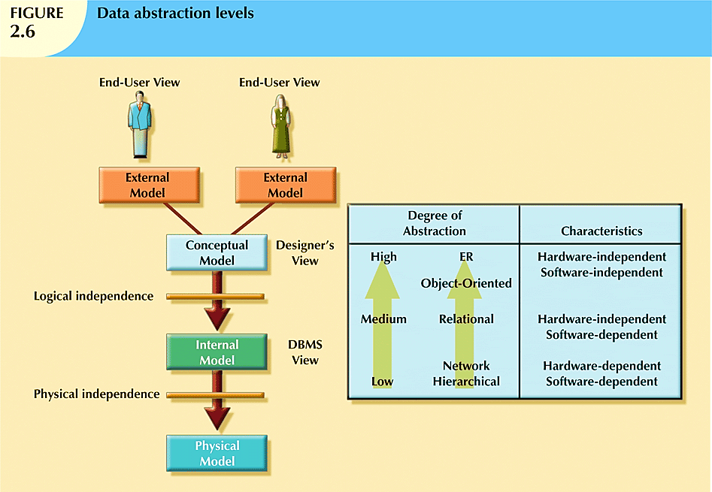
http://www.uobabylon.edu.iq/uobColeges/ad_downloads/5_25125_38.pdf
If you ask ten data base designers what is a data model, you will end up with ten different answers. Depending on the degree of data abstraction. In 1970s the American National standards Institute (ANSI) defined a framework for data modeling based on degrees of data abstraction.

Slide 44
The External Model
End users’ view of the data environment
ER diagrams are used to represent the external views
External schema: Specific representation of an external view

Slide 45
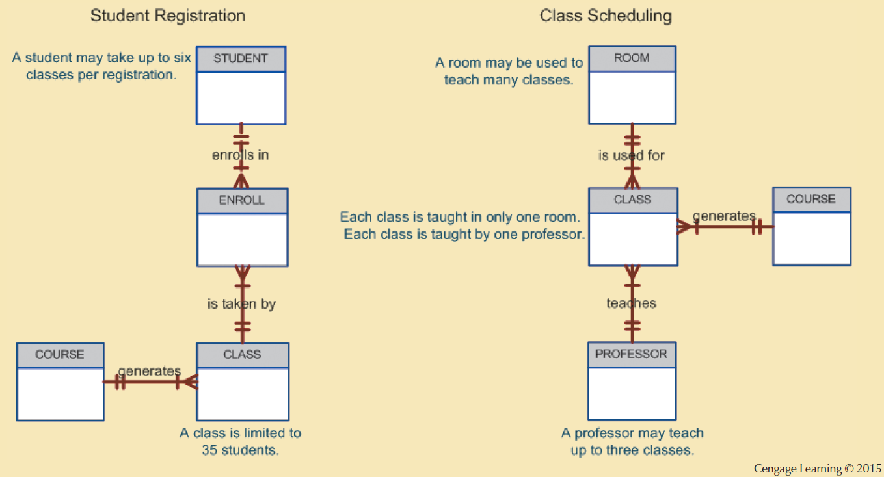
Figure 2.7 - External Models for Tiny College

Slide 46
The Conceptual Model
Represents a global view of the entire database by the entire organization
Conceptual schema: Basis for the identification and high-level description of the main data objects
Has a macro-level view of data environment
Is software and hardware independent
Logical design: Task of creating a conceptual data model

Slide 47
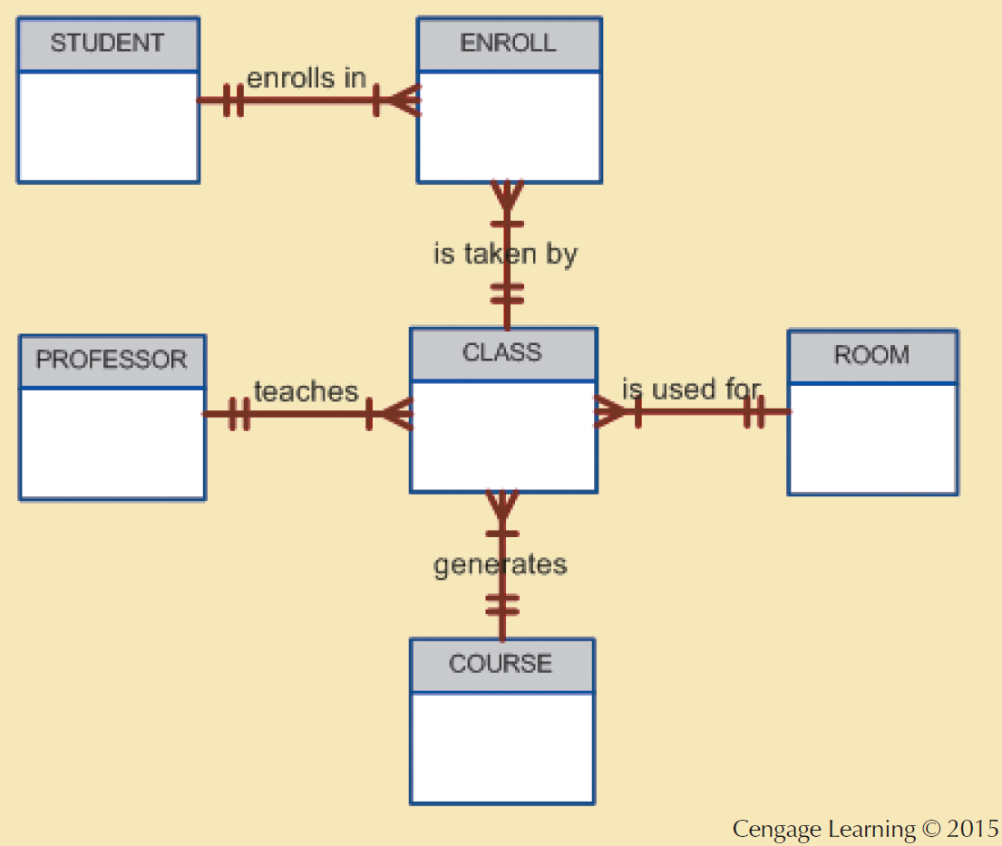
Figure 2.8 - Conceptual Model for Tiny College

Slide 48
The Internal Model
Representing database as seen by the DBMS mapping conceptual model to the DBMS
Internal schema: Specific representation of an internal model
  Uses the database constructs supported by the chosen database
Is software dependent and hardware independent
Logical independence: Changing internal model without affecting the conceptual model

Slide 49
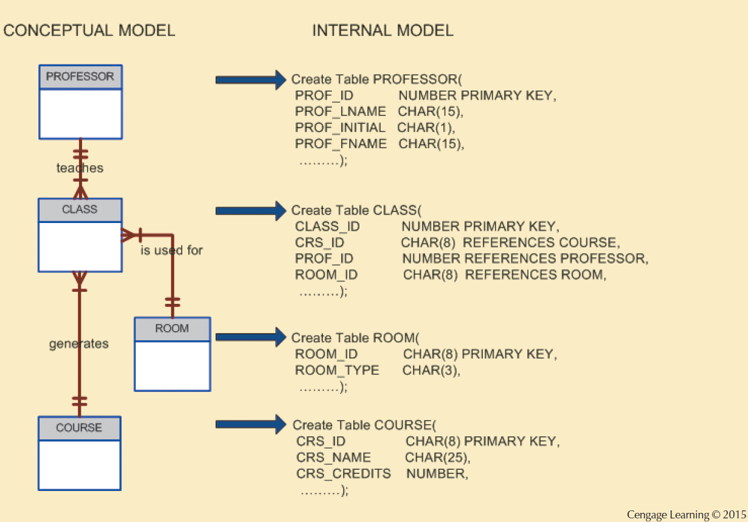
Figure 2.9 - Internal Model for Tiny College

Slide 50
The Physical Model
Operates at lowest level of abstraction
Describes the way data are saved on storage media such as disks or tapes
Requires the definition of physical storage and data access methods
Relational model aimed at logical level
  Does not require physical-level details
Physical independence: Changes in physical model do not affect internal model

Slide 51
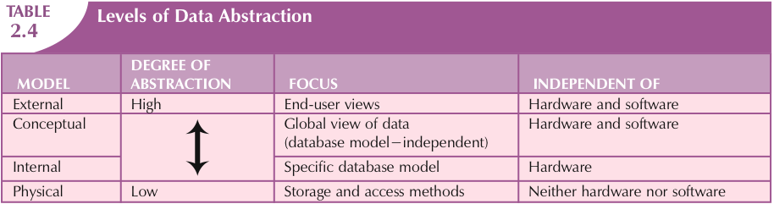

Slide 52
Summary
A data model is an abstraction of a complex real-world data environment
Basic data modeling components:
  Entities
  Attributes
  Relationships
  Constraints
Business rules identify and define basic modeling components

Slide 53
Summary (cont’d.)
Hierarchical model
  Set of one-to-many (1:M) relationships between a parent and its children segments
Network data model
  Uses sets to represent 1:M relationships between record types
Relational model
  Current database implementation standard
  ER model is a tool for data modeling
    Complements relational model

Slide 54
Summary (cont’d.)
Object-oriented data model: object is basic modeling structure
Relational model adopted object-oriented extensions: extended relational data model (ERDM)
OO data models depicted using UML
Data-modeling requirements are a function of different data views and abstraction levels
  Three abstraction levels: external, conceptual, internal

